Slide 1

Cannabis: Cash Crop or Crime Boom?
Alexander Fong
GitHub: WhimsicalNose03

Slide 2


Context:
My project inspiration came from an article on Forbes claiming that “violent crime” has been on the rise in California since legalizing Cannabis in 2018. The words painted a picture of “Weed Pirates”, criminals who would come across state lines, snatch up all the Marijuana they could get their hands on, and return home to sell.
Notes:
After reading the article the first thought that came to mind was ‘Weed Pirates’, and dismissed it as propaganda to scare other states.

Slide 3

Process:
Data Collection: Collected data on Seattle and several cities I thought would serve as good controls. Only Portland ended up being viable.
Data Cleaning and Visualization: Every city has a different protocol for data entry. Once cleaned, I had to check each proposed control group for viability.
Hypothesis testing: Once a control was established, I ran a series of hypothesis tests for types of crime associated with piracy with 𝛼 = 0.05:
H(null): There is no significant change in these crime rates coinciding with the legalization of Cannabis
H(alt): There is a significant change in crime rates coinciding with the legalization of Cannabis

Slide 4
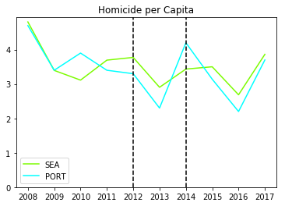
Homicide
There is a visual spike in Seattles Homicide rate in 2012, however this result is not statistically significant.
We observe the same change in 2014 when Portland legalized, but again this is not statistically significant.
Notes:
Pre - : You can see how murders basically line up
In 2010: while the trends veer off our math shows that this is not a statistically significant difference (z = -0.7303, p = -0.4654)
Post- : After legalization we can see that our trends still line up. We check 2014:
In 2014: trends move in the same direction, and there is not enough evidence for us to claim that they are truly different (z = -0.981, p = 0.327)
There is no evidence here that ‘Weed Pirates’ have increased the murder rate

Slide 5
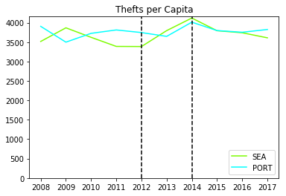
Thefts
There is a significant increase in Thefts in Seattle in the years following legalization
However, we see the opposite in Portland
This could indicate a different regional effect impacting thefts between 2012 and 2014.
Notes:
2012: z = -10.8, p < .00001. Significant difference
2013: z = 4.36, p < .00001. Significant difference
2014: z = 3.04, p = .00236. Significant difference

Slide 6
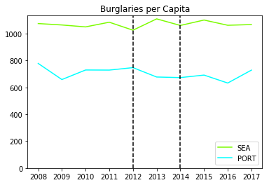
Burglary
One could argue that Seattle experiences a rise in Burglary we do not see that trend continue.
Furthermore we do not observe the same kind of spike in Portland
Notes:
Sea 2012 - 2013: z = -1.97, p= 0.0488

Slide 7
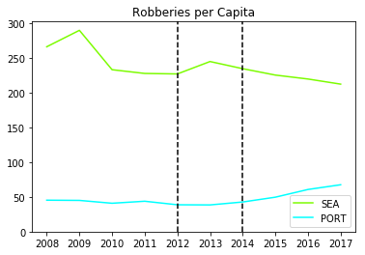
Robbery
While there is a visual increase in robberies in Seattle after legalization, this rise is not statistically significant.
The same can be said of Portland following their legalization event.
Notes:
Sea Robb 12-13: z = -0.953, p=.342

Slide 8

Results and Next Steps
Based on this data we cannot conclude that Weed Pirates are causing a significant increase in crime. Instead, I observe a continuation of trends existing before legalization.
Next Steps:
Identify more Control Cities for Seattle
Evaluate other types of crime to see where legalization had an impact
Apply the same process to a different test city
Perform trend analysis to verify our findings

